Slide 1
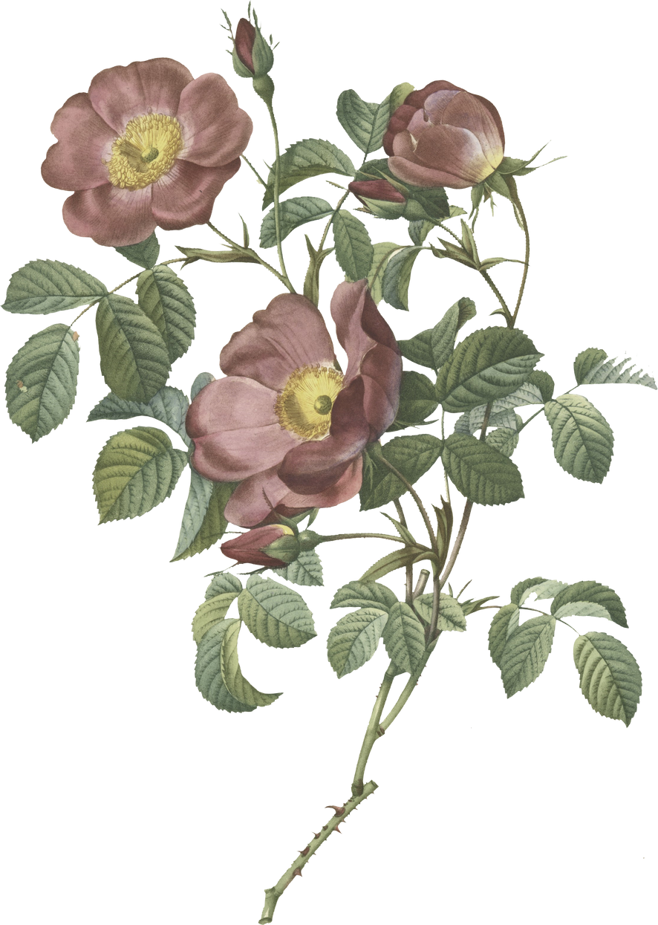
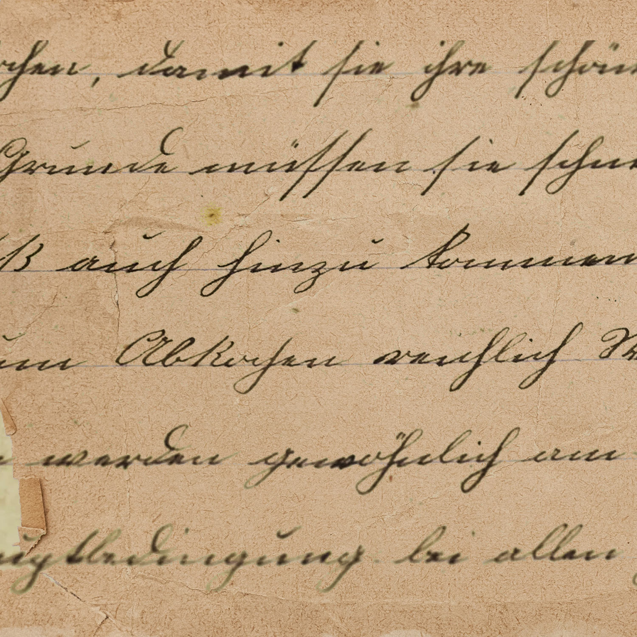







Artistic
creation

Slide 2



Team Members
RANJAN BARIA
AANCHAL
KUMARI
SANIYA RANA

Slide 3
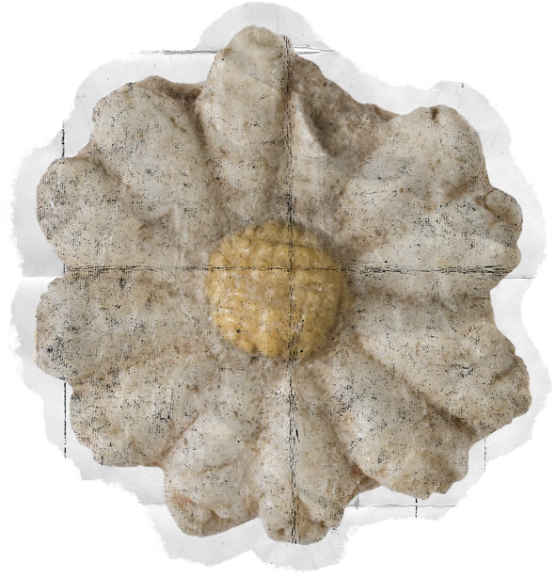




01
Introduction
Artistic creation is an inclusive e-commerce platform designed to promote and sell authentic Indian handicrafts made by economically weaker sections. The goal is to offer them a direct-to-consumer marketplace where they can earn fair income, gain visibility, and achieve social and financial independence.

Slide 4
02
Why we choose this project?
Our main aim of this project is to help women artisans who are not getting the correct value for there handmade products.
The another aim is , they are not getting the correct marketplace to sell there products, and if they get any they sell there products at a very huge rate without providing them a profit they deserved.
Our aim is not only to provide a platform but also to offer the perfect price for their product, helping them sell at its true value.

Slide 5


03
Objectives
Promote Indian Handicrafts : Highlight and preserve traditional art by showcasing handmade products from across India.
Empower Local Artisans: Provide a platform for rural to showcase and sell their talent, ensuring inclusive growth.

Slide 6
04
Key Features
Empowering Artisans
A platform that uplifts rural artisans by showcasing their handmade talent.
Emotion-Driven Shopping
Not just products — buy culture, tradition, and passion wrapped in every handcrafted piece.

Slide 7


05
Project Goals
Goal 2
Goal 3
Goal 1
Celebrate Indian Culture & Creativity
Promote Indian Culture Through Art
Give Every Artisan a Voice
Bring the beauty of handmade traditions to modern buyers who value stories, not just products.
Preserve and spread cultural heritage by showcasing region-specific handmade products.
Create an online platform where traditional artisans can sell their handcrafted products easily.

Slide 8
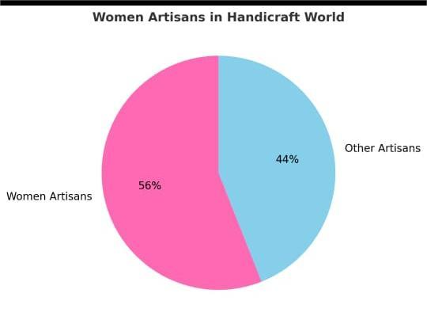
06
Art Without Barriers: Highlighting Disabled Artisans
Around 56.1% of artisans in the handic raft world are women - showcasing their immense creativity, dedication, and role in preserving traditional art forms.
Artistic Creation aims to give these women the platform they deserve, helping them transform their talent into sustainable livelihoods and recognition

Slide 9

Tech Stack
07
Frontend: HTML,CSS,Bootstrap
Backend: Python,Php,mysql
Database: Firebase
Other: Postman,Github

Slide 10
Conclusion
Empowering local artists to reach new heights and supporting those whose livelihood depends on their craft.
This project supports and strengthens the Prime Minister’s ‘Vocal for Local’ initiative, promoting indigenous talent and self-reliance.
It contributes to the preservation, protection, and promotion of India’s heritage.

Slide 11
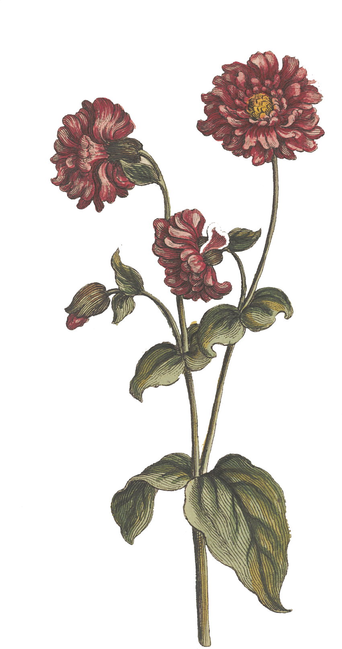
Thank you for your attention. We’re happy to answer your questions.

Slide 12

Thank
you

